Slide 1
Detecting Illegal Fishing with Automatic Identification Systems and Machine Learning
Samuel Brown, Danielle Katz,
Dana Korotovskikh, and Stephen Kullman
1 May 2024

Slide 2
Table of Contents
Stakeholders
Background and Motivation
Data Discussion
Assumptions and Limitations
Methodology
Data Pipelines and Processing
Modeling

Slide 3
Stakeholders
Sponsor: GA-CCRi
Tara Valladares
Rebecca DeSipio
Mentor: Heman Shakeri

Slide 4
Introduction

Slide 5
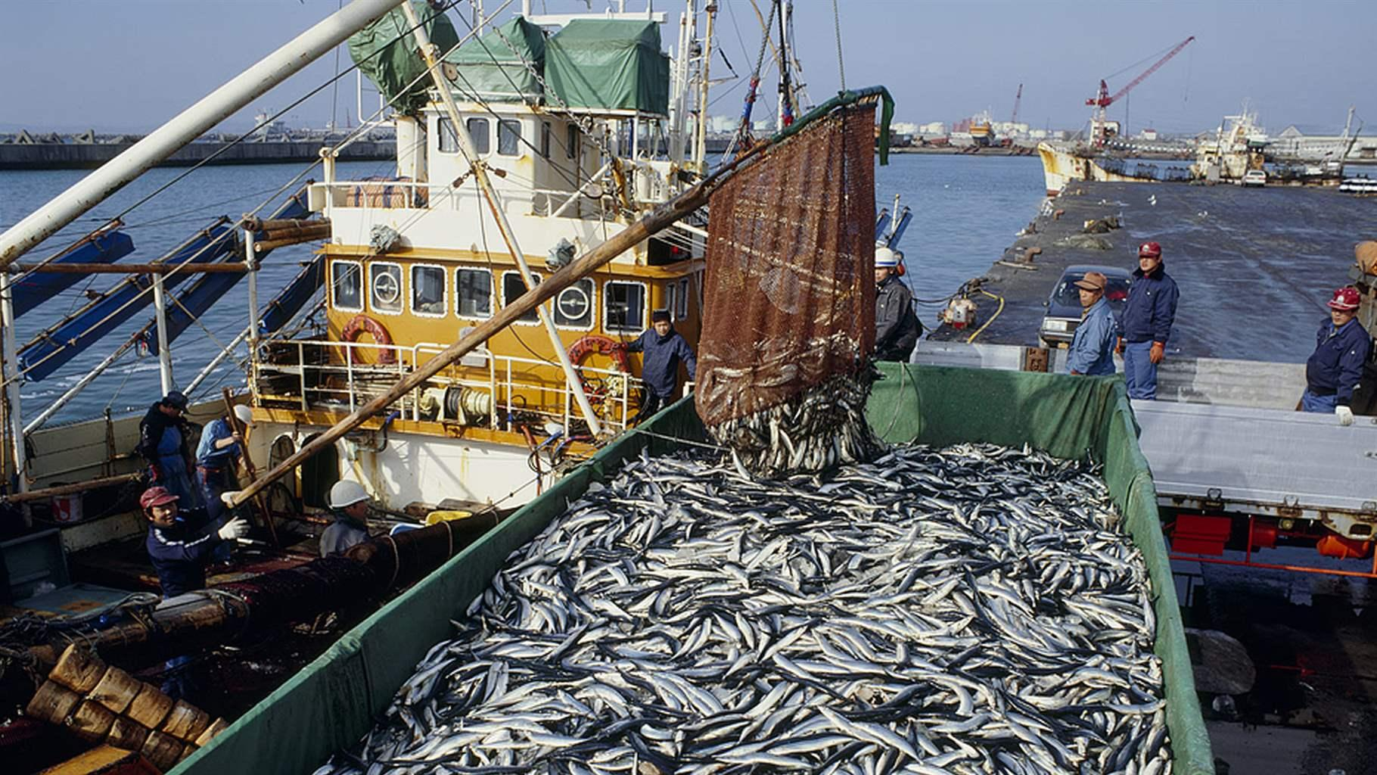
Illegal, Unreported, and Unregulated (IUU) Fishing
Widely defined – fishing outside of local or international regulations
Critical issue impacting health of marine ecosystem and global security
Estimated to cost $10-23 billion annually
Notes:
…contravening local fishery laws, falsifying reports to authorities, or fishing in protected waters
…Nearly half of the world’s population relies on fish for a portion of their protein intake. Over-fishing affects every country, but especially those nations who are more reliant on the sea for resources
…The problem is complex, spanning multiple jurisdictions with patchwork laws, if the laws are enforced to begin with. Solutions require cooperation between nations that may have opposing geopolitical goals. But it is not hopeless. The intervention is somewhat easier than fighting drug trafficking, and the emergence of Big Data have given nations tools to fight back. Fish, fresh or frozen, legally caught or otherwise, lose value as they age. Machine learning that can help predict suspected illegal activity can give port authorities motive to delay fish sales, eating away at profit margins.

Slide 6
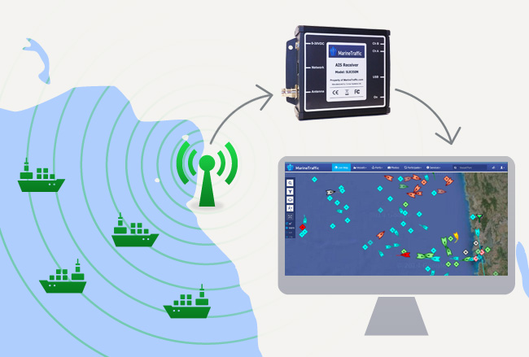
Automatic Identification Systems (AIS)
Standardized tracking systems outfitted on all vessels
Continuously transmits user data
Utilized for maritime monitoring and collision avoidance
Very available and easy to obtain
Notes:
Many thanks to our capstone advisor, Dr. Fox and Khairul, both whom provided exceptional help throughout the entire process.

Slide 7
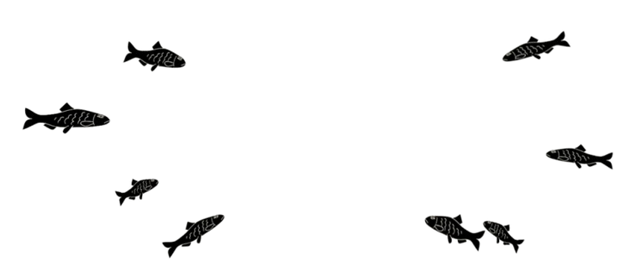
Motivation
AIS devices are commonly illegally exploited on fishing nets and buoys to protect large hauls
Increased need to reform AIS regulations
Goal:
Explore how AIS data can be used to
aid in IUU fishing net detection

Slide 8
Data

Slide 9
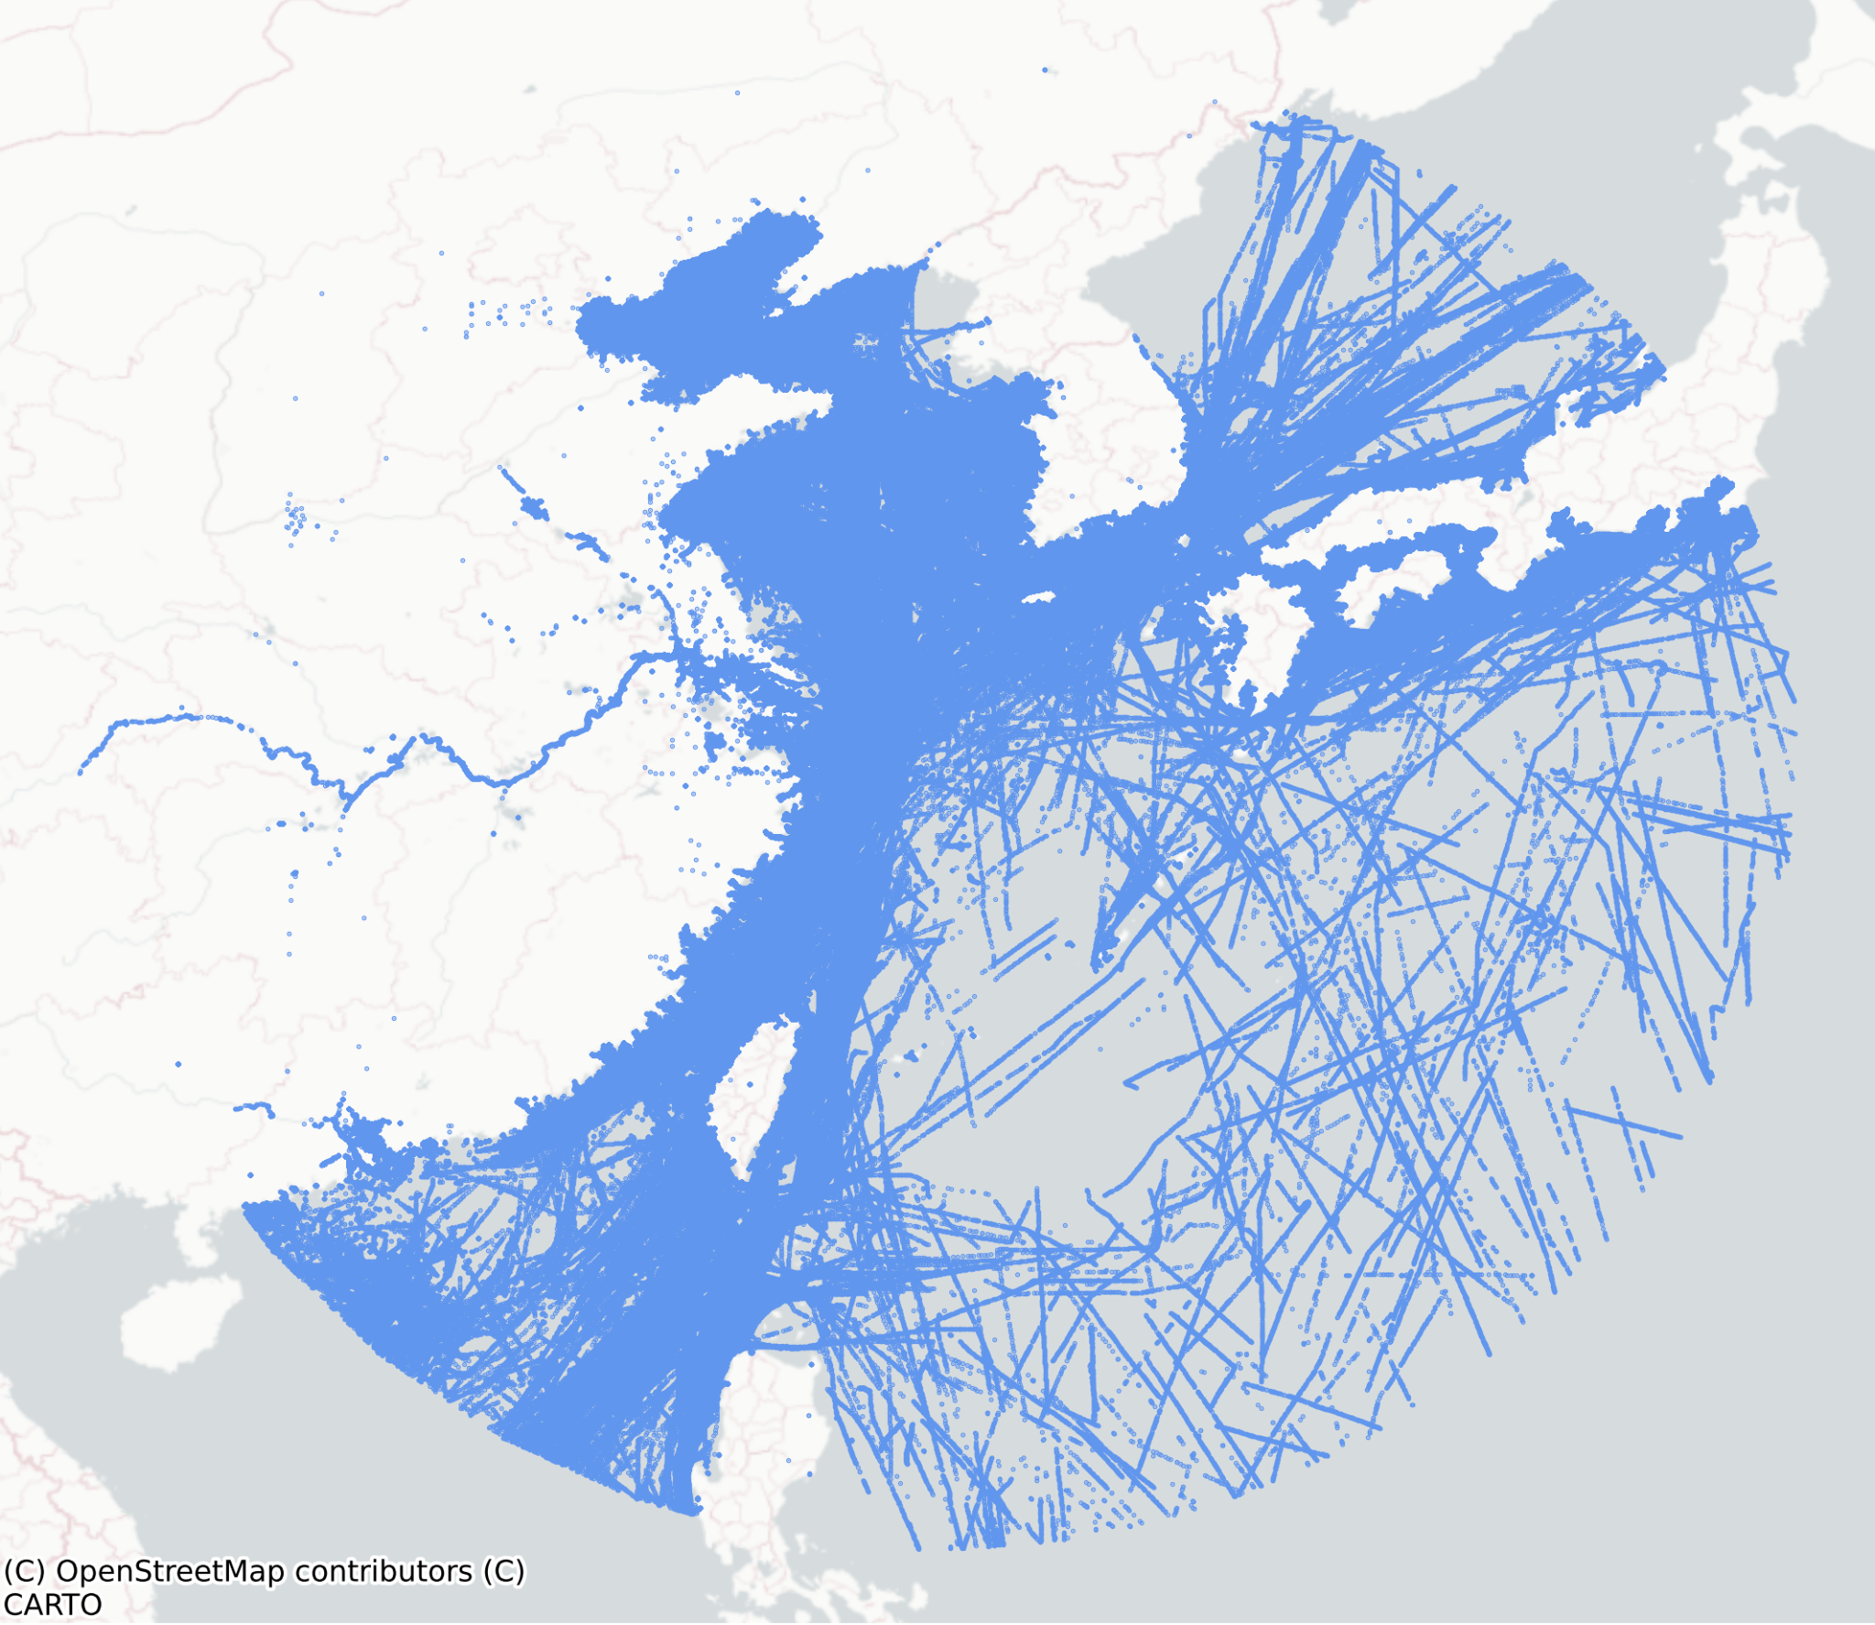
Area Overview
Region of interest:
Southeast Asia
Spatial, temporal, and user inputted data
Training set
Around 4 days
September 1→5 2023
Test set
Around 4 days
October 12→16 2023

Slide 10
Assumptions and Limitations
%
Certain naming or positional conventions are suggestive of fishing nets
“Net”
V
“Buoy”
Computational limitations led to restricted region of
interest and timeframe

Slide 11
Methodology

Slide 12
Pre-Processing
Aggregate data by distinct device ‘trips’
Unbroken period of AIS transmission
Included scaled parameters for speed, heading, and positioning
net_name | Names including a ‘V’, ‘%’, ’buoy’, or ’net’
mmsi_length | MMSI values not equal to 9 digits
spawn_offshore | Vessels whose first transmission is offshore (1 nautical mile off coastline)
spoof | Devices with unreasonably high calculated speeds (≥ 150 knots)
Red flag : Indicators of non-standard naming conventions and movement
Score from 0→4
Used for modelling analysis

Slide 13
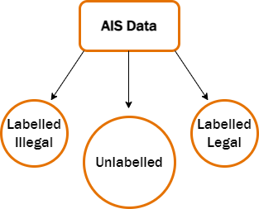
Pseudo-Labelling
AIS dataset is unlabelled
Select models utilized pseudo-labels for training
Pseudo-labelled confident points based on ‘red flag’ conditions
Illegal: Bad net_name and ≥ 3 total red flags
Legal: No red flags

Slide 14
Approaches
Unsupervised clustering
Hierarchical Density-Based Spatial Clustering of Applications with Noise (HDBSCAN)
Semi-supervised classification
eXtreme Gradient Boosted trees (XGBoost) and Artificial Neural Network (ANN)
Supervised classification
ANN

Slide 15
Models

Slide 16
Unsupervised Clustering
Treats dataset as truly unlabelled
Clustering with HDBSCAN
2 clustering iterations
After first round new score is built:
Aggregates mean red flag score of each cluster onto respective observations

Slide 17
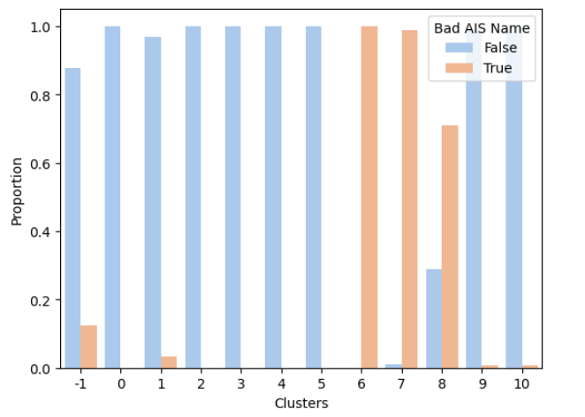
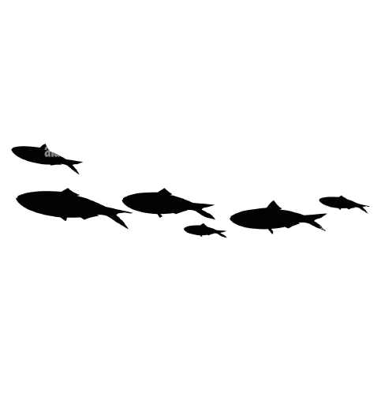
Unsupervised Clustering Results
Cluster Results Analyzed by net_name
3 primary clusters identified
Reflect 36.2% of total trips in dataset
Includes 1% of observations with valid net_name
The developed features may be valid indicators of IUU activity that cannot be detected with naming conventions alone

Slide 18
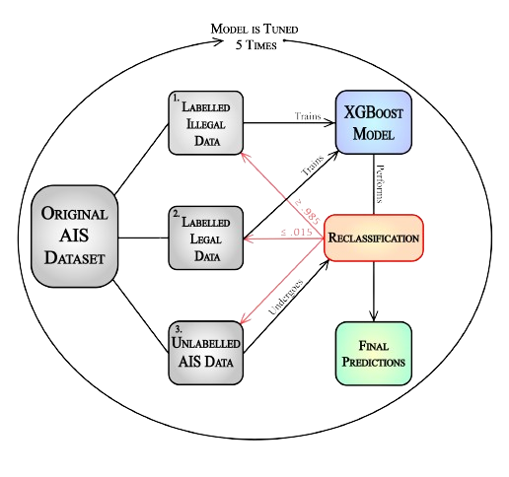
Semi-Supervised Classification
Workflow for XGBoost & ANN
Small set of confident pseudo-labelled points, other points are left unlabelled
Model trained on sample of labelled AIS data
Iteratively classifies unlabelled dataset if confident and retrains on updated labelled dataset

Slide 19
Supervised Classification with ANN
Uses pseudo-labelled training data once to build model
Simple ANN predicts binary classification for each AIS trip
Same 4-layer ANN framework used for both semi and fully supervised models

Slide 20
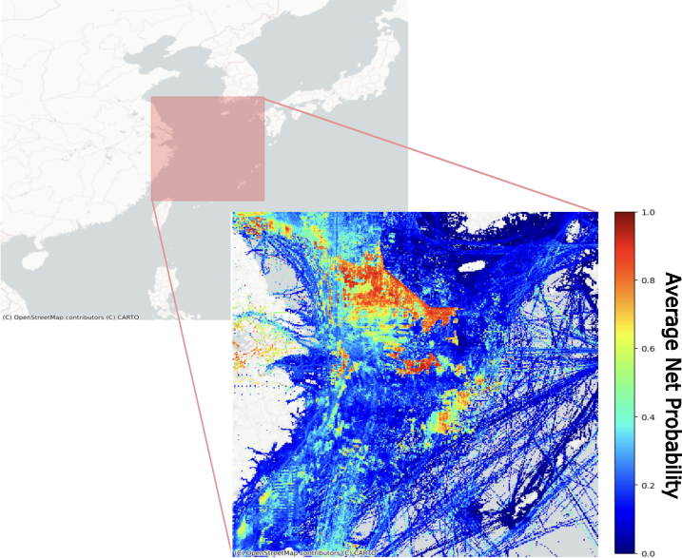
Semi-Supervised and Supervised
Classification Results
Probability of 1 indicates illegal likely to have occured in region
Heatmap of XGBoost prediction results on test set (~100 hours)
Model | Test Accuracy | TPR | TNR
**Semi-supervised XGBoost | 0.891 | 0.915 | 0.848
Semi-supervised ANN | 0.879 | 0.900 | 0.842
Supervised ANN | 0.867 | 0.907 | 0.801
**XGBoost model was the top performer with test set

Slide 21
Regional Analysis
Divided region into .1°x.1° cells
36 mi²
hot_score: number of unique red flags divided by count of unique vessels
Position each AIS signal within its corresponding grid cell
Calculate total number of ‘red flags’ per unique vessel for each cell
Aggregate each hours’ score per cell to see which areas showed most signs of illegal activity per day

Slide 22
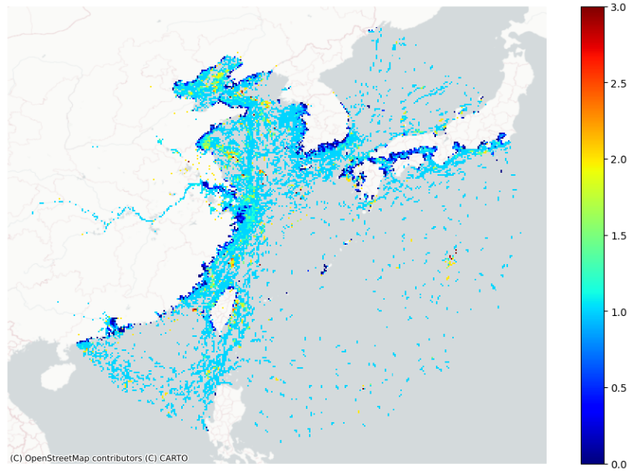
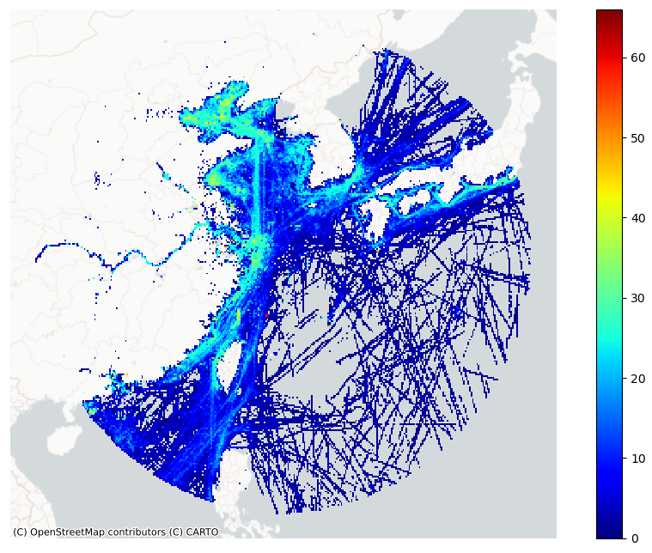
Regional Analysis Visual Results
September 1st, 1 hour
September 1st, 24 hours

Slide 23
Special thanks to Tara Vallardes, Rebecca DeSipio, and Heman Shakeri for their expertise throughout! We could not have accomplished this without their help. ❤
Acknowledgements

Slide 24
Capstone Team
Samuel Brown
Danielle Katz
Dana Korotovskikh
Stephen Kullman

